Slide 1
HTOL TMON Analysis Alert System
Focus on Chiller Water Pressure variable
Artem Moshnin

Slide 2
Method 1 : Threshold-based Approach
Core Principal of the System:
The system dynamically monitors the sensor value and compares it against predefined thresholds that vary depending on whether the machine is "idle" or "running."
If the sensor value crosses these thresholds, it triggers an alert if the number of outliers is above the tolerance threshold, with the severity of the alert corresponding to how far the value deviates from the normal range.
Advantages
Simple and Intuitive: Easy to understand and implement
Real-time Monitoring: Provides immediate alerts for deviations
Limitations
Fixed Thresholds: May not adapt well to changes in the machine's behavior or environmental conditions
Potential for False Alarms: Transient fluctuations or noise in the sensor data could trigger unnecessary alerts
Conclusion
Overall, the threshold-based approach offers a straightforward way to monitor the HTOL machine's sensor and promptly alert operators of any abnormal conditions.

Slide 3
Method 1 : Threshold-based Approach
Outlier Tolerance:
The system dynamically monitors the sensor value and compares it against predefined thresholds that vary depending on whether the machine is "idle" or "running."
If the sensor value crosses these thresholds, it triggers an alert if the number of outliers is above the tolerance threshold, with the severity of the alert corresponding to how far the value deviates from the normal range.
- Controls Sensitivity: outliers_tolerance acts as a buffer against sporadic fluctuations or noise in the sensor data. A higher value makes the system less sensitive to brief deviations, reducing the likelihood of false alarms.
- Balances Responsiveness: A lower value increases the system's responsiveness to genuine anomalies but might also lead to more false positives if the sensor data is inherently noisy.

Slide 4
Method 1 : Threshold-based Approach
Operational States and Thresholds
The code dynamically sets thresholds based on the machine's operational state (idle or running).
For the 'idle' state, the bounds are the following:
Normal operation: 32 +- 1
Non-Normal Operation (Low Severity): In between 32 +- 1 and 32 +- 3
Non-Normal Operation (Medium Severity): In between 32 +- 3 and 32 +- 5
Non-Normal Operation (High Severity): In between 32 +- 5 and +- infinity
For the 'running' state, the bounds are the following:
Normal operation: 32 +- 3
Non-Normal Operation (Low Severity): In between 32 +- 3 and 32 +- 5
Non-Normal Operation (Medium Severity): In between 32 +- 5 and 32 +- 7
Non-Normal Operation (High Severity): In between 32 +- 7 and +- infinity

Slide 5
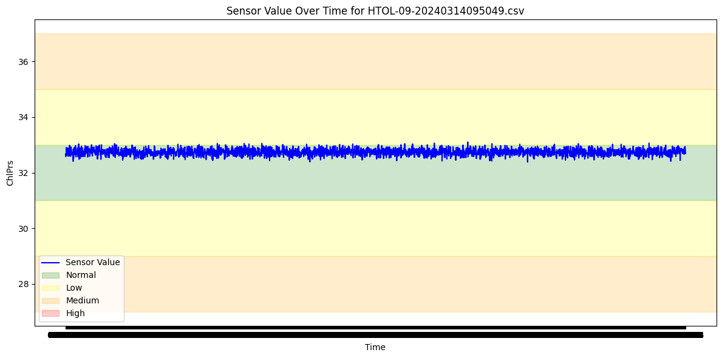
Method 1 : Threshold-based Approach
Samples of Results (Normal Operation) (HTOL-9)

Slide 6
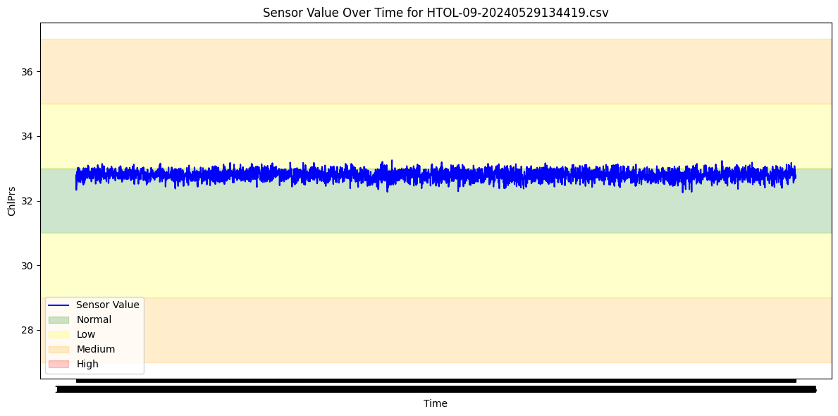
Method 1 : Threshold-based Approach
Samples of Results (Normal Operation) (HTOL-9)
Non-prolonged fluctuations (ie: noise) above normal operation is ignored.
Because consecutive outlier tolerance is 10.

Slide 7
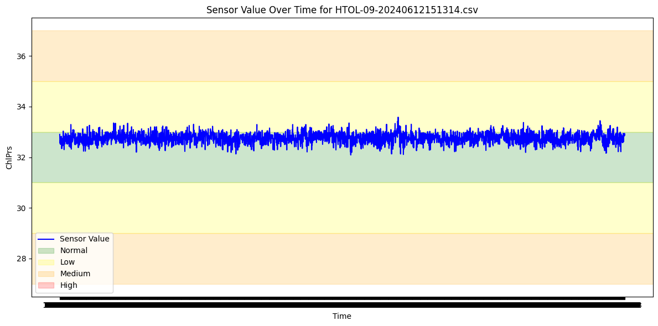
Method 1 : Threshold-based Approach
Samples of Results (Normal Operation) (HTOL-9)
Occasional Spikes (outliers) are ignored. Because consecutive outlier tolerance is 10.

Slide 8
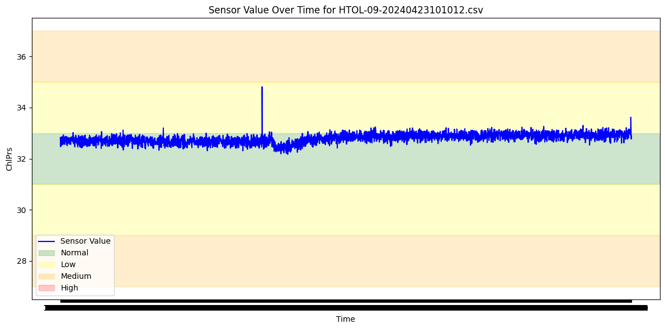
Method 1 : Threshold-based Approach
Samples of Results (Normal Operation) (HTOL-9)
Occasional Spikes (outliers) are ignored. Because consecutive outlier tolerance is 10.

Slide 9
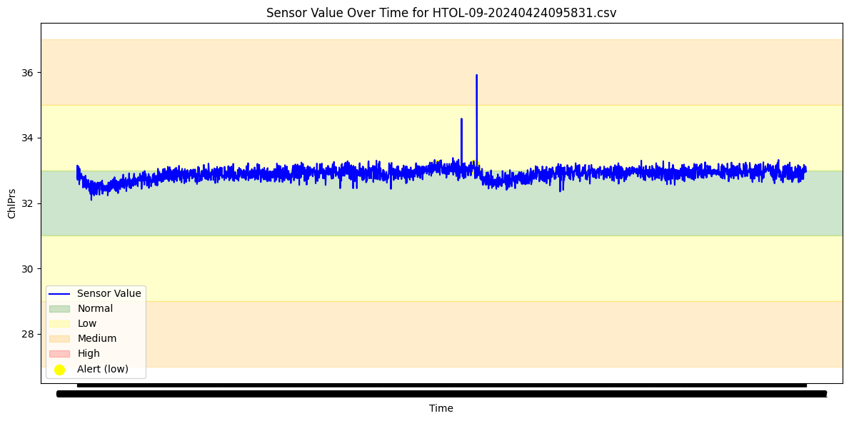
Method 1 : Threshold-based Approach
Samples of Results (Normal Operation) (HTOL-9)
Occasional Spikes (outliers) are ignored. Because consecutive outlier tolerance is 10.

Slide 10
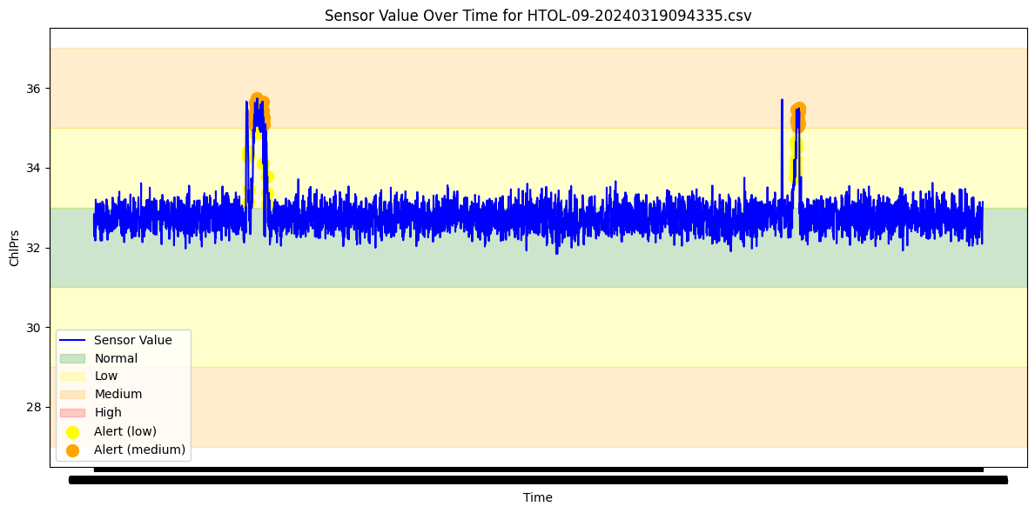
Method 1 : Threshold-based Approach
Samples of Results (Non-Normal Operation) (HTOL-9)
Prolonged operation in non-normal operation regions (low and medium zones)

Slide 11
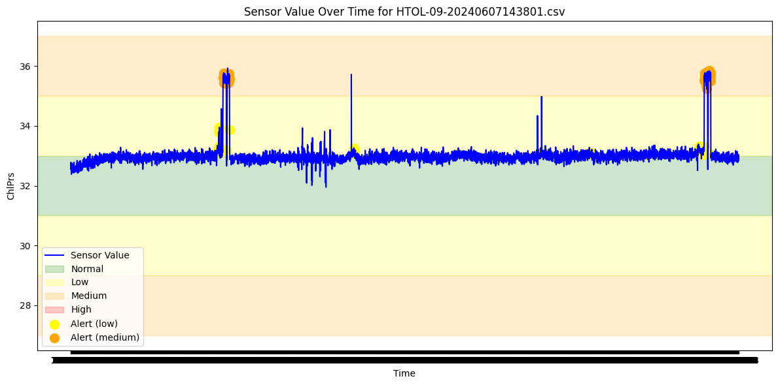
Method 1 : Threshold-based Approach
Samples of Results (Non-Normal Operation) (HTOL-9)
Prolonged operation in non-normal operation regions (low and medium zones)

Slide 12
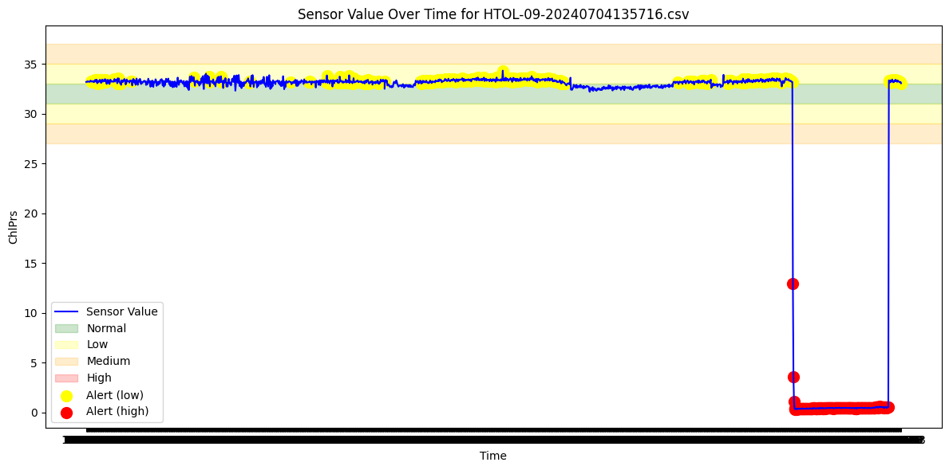
Method 1 : Threshold-based Approach
Samples of Results (Non-Normal Operation) (HTOL-9)
Prolonged operation in non-normal operation regions (low and high zones)

Slide 13
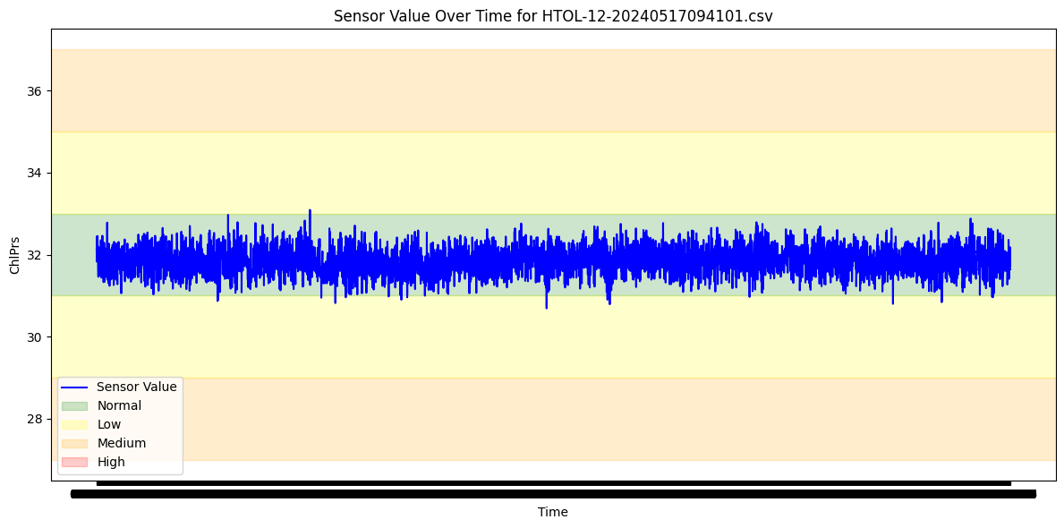
Method 1 : Threshold-based Approach
Samples of Results (Non-Normal Operation) (HTOL-12)
Occasional Spikes (outliers) are ignored. Because consecutive outlier tolerance is 10.

Slide 14
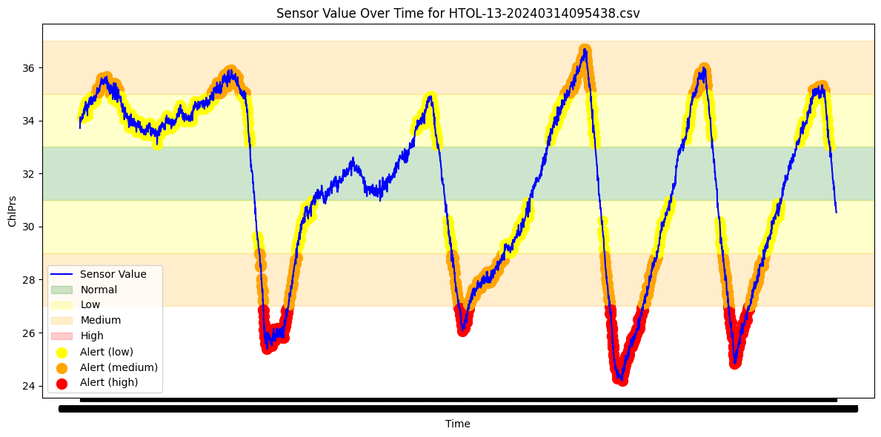
Method 1 : Threshold-based Approach
Samples of Results (Non-Normal Operation) (HTOL-13)
Prolonged operation in non-normal operation regions is detected.

Slide 15
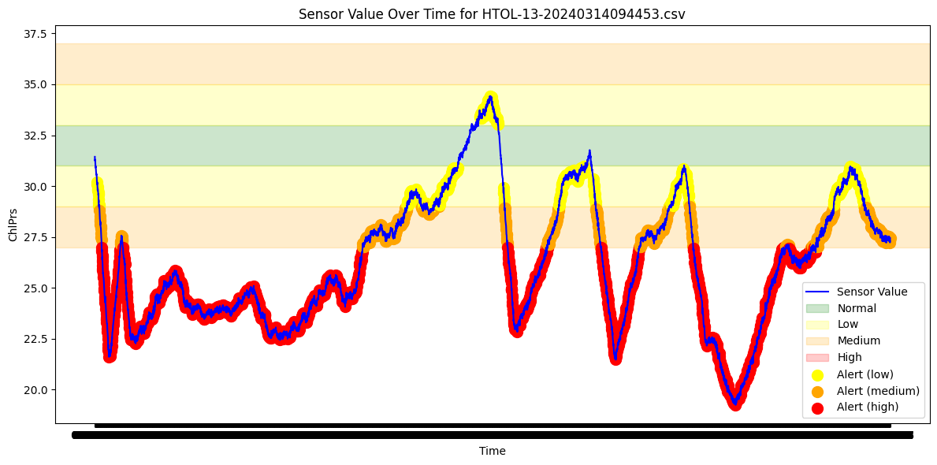
Method 1 : Threshold-based Approach
Samples of Results (Non-Normal Operation) (HTOL-13)
Prolonged operation in non-normal operation regions is detected.

Slide 16
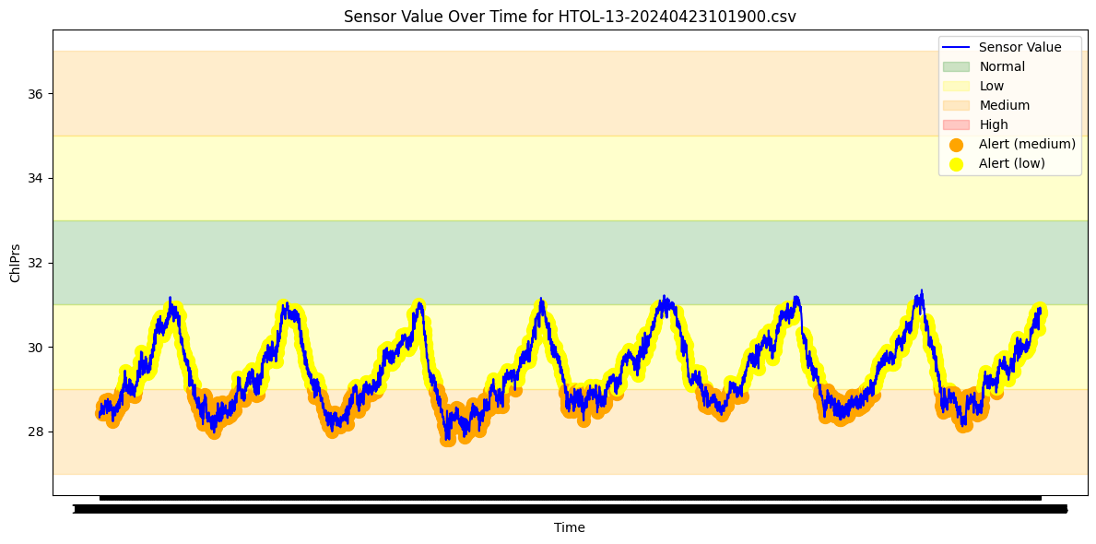
Method 1 : Threshold-based Approach
Samples of Results (Non-Normal Operation) (HTOL-13)
Prolonged operation in non-normal operation regions is detected.

Slide 17
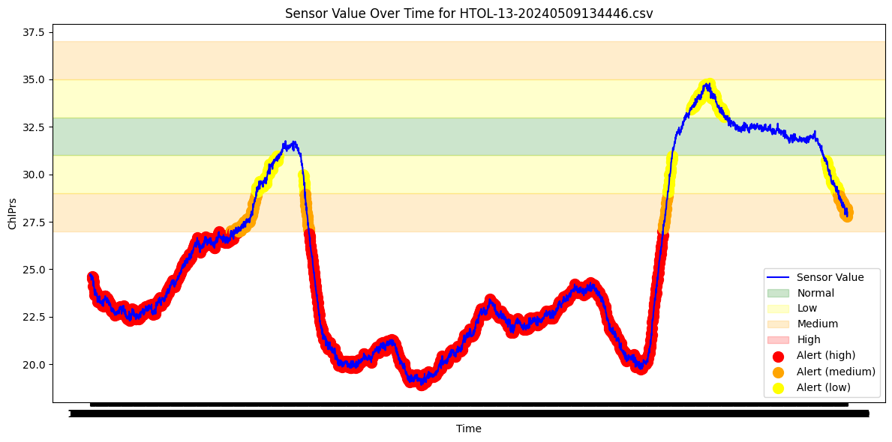
Method 1 : Threshold-based Approach
Samples of Results (Non-Normal Operation) (HTOL-13)
Prolonged operation in non-normal operation regions is detected.

Slide 18
Method 2 : 6-Sigma Rule (Statistical Method)
Core Principal of the System:
The 6-sigma rule is grounded in statistical process control. It assumes that sensor values, under normal operation, follow a Gaussian (normal) distribution. Any value falling outside the range defined by six standard deviations (sigmas) from the mean is considered an anomaly.
Advantages
Adaptability: The 6-sigma rule dynamically adjusts its control limits based on the actual variability of the sensor data. This makes it more resilient to changes in the machine's behavior or environmental conditions, potentially reducing false alarms compared to fixed thresholds.
Sudden Changes Detector: Exceptionally good at detecting any sudden spikes as compared to the usual trend of the sensor data.
Disadvantages
Data Dependency: It requires sufficient historical data to accurately estimate the mean and standard deviation for each state. In scenarios with limited data or evolving processes, the 6-sigma rule might be less effective initially.
Threshold Agnostic: As you rightly observed, the 6-sigma rule doesn't inherently incorporate predefined thresholds for different operational states (idle/running). It focuses on deviations from the statistical norm, which might not always align with the specific operational requirements.
Delayed Response to Shifts: While it adapts to gradual changes, it might be slower to respond to sudden shifts in the process mean or standard deviation compared to a threshold-based approach that immediately flags values outside the fixed bounds.

Slide 19
Method 2 : 6-Sigma Rule (Statistical Method)
Comparison between Threshold Approach and 6-Sigma Rule
Sensitivity vs Specificity:
The 6-sigma rule tends to be more specific (fewer false positives) but might be less sensitive to certain types of anomalies, especially those related to exceeding predefined operational thresholds.
The threshold-based method, on the other hand, is highly sensitive to threshold violations but might generate more false alarms due to normal fluctuations within the expected range.

Slide 20
Method 2 : 6-Sigma Rule (Statistical Method)
Potential for Combining Methods
Hybrid approach could leverage their strengths:
Primary Detection: Use the 6-sigma rule for its adaptability and statistical rigor in detecting general anomalies.
Threshold-Based Overlay: Implement a threshold-based check on top of the 6-sigma rule to specifically capture instances where sensor values cross critical operational boundaries, even if they fall within the statistically acceptable range.
The need for a hybrid approach depends on the desired alerting system requirements.

Slide 21
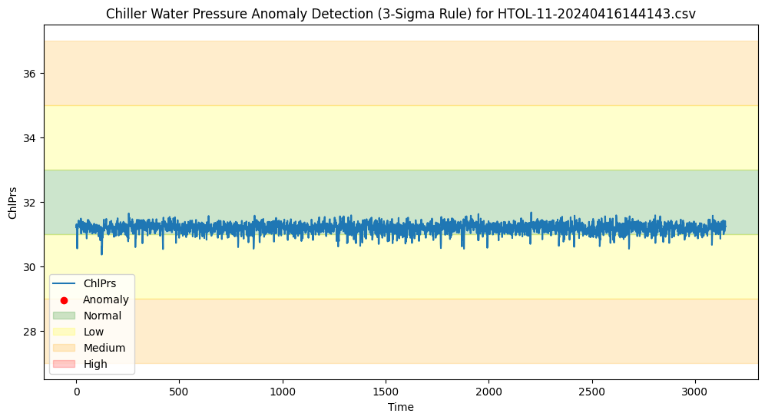
Method 2 : 6-Sigma Rule (Statistical Method)
Samples of Results (Normal Operation) (HTOL-11)
No sudden spikes (that are more than 6 sigmas away) – no alerts

Slide 22
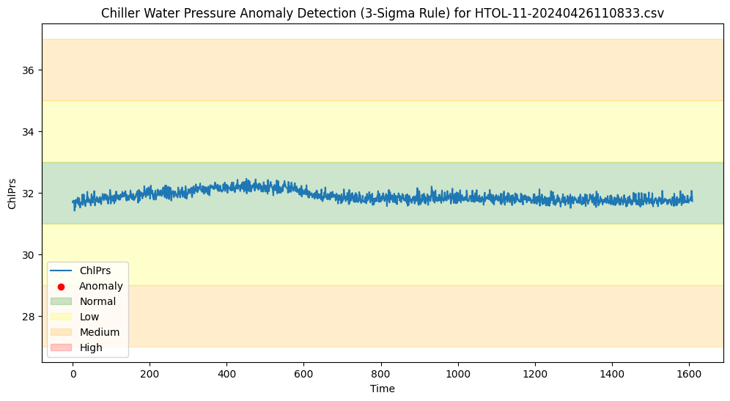
Method 2 : 6-Sigma Rule (Statistical Method)
Samples of Results (Normal Operation) (HTOL-11)
No sudden spikes (that are more than 6 sigmas away) – no alerts

Slide 23
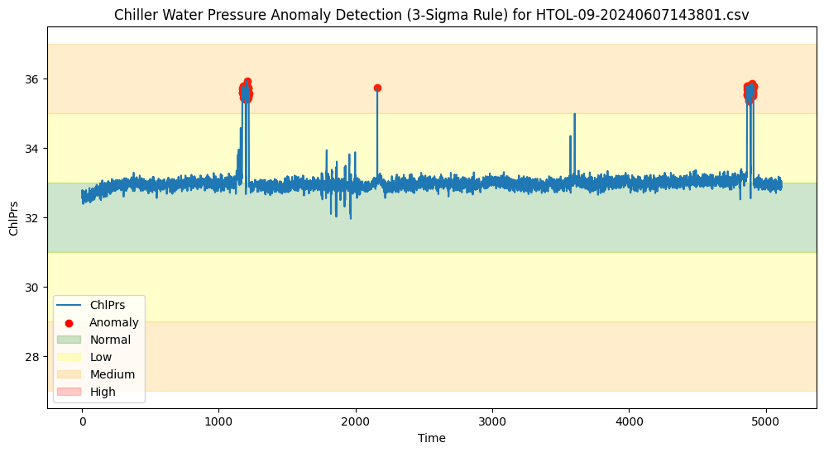
Method 2 : 6-Sigma Rule (Statistical Method)
Samples of Results (Normal Operation) (HTOL-11)
Sudden spikes (that are more than 6 sigmas away) – alerts

Slide 24
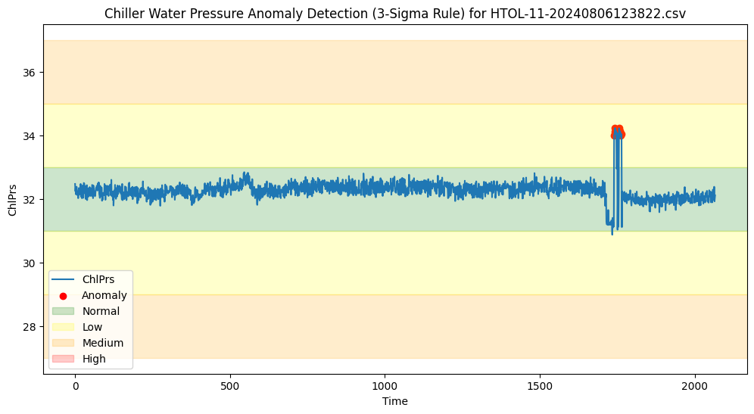
Method 2 : 6-Sigma Rule (Statistical Method)
Samples of Results (Normal Operation) (HTOL-11)
Sudden spikes (that are more than 6 sigmas away) – alerts

Slide 25
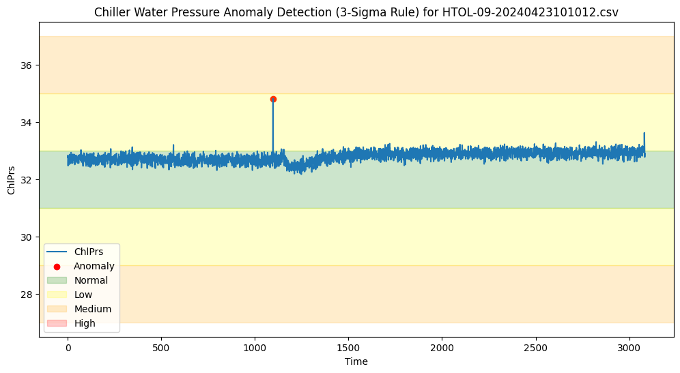
Method 2 : 6-Sigma Rule (Statistical Method)
Samples of Results (Normal Operation) (HTOL-11)
Sudden spikes (that are more than 6 sigmas away) – alerts

Slide 26
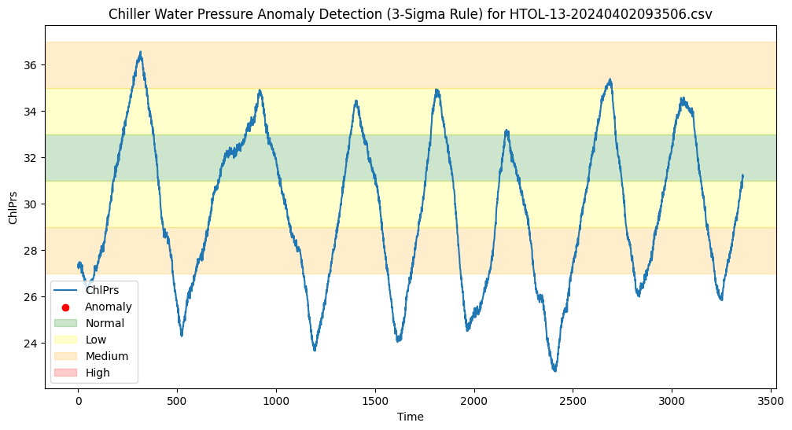
Method 2 : 6-Sigma Rule (Statistical Method)
Samples of Results (Normal Operation) (HTOL-13)
Outside normal operation regions, but no spikes – no alerts

Slide 27
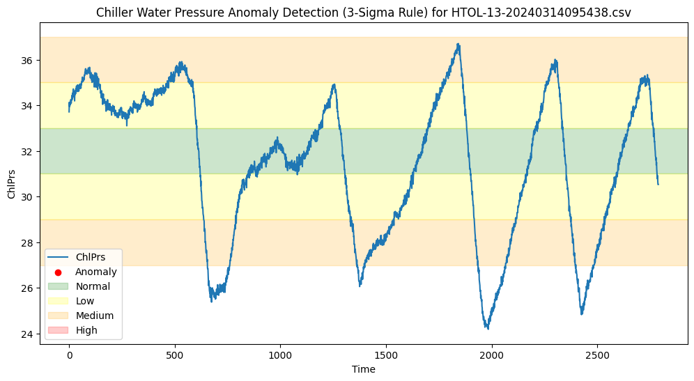
Method 2 : 6-Sigma Rule (Statistical Method)
Samples of Results (Normal Operation) (HTOL-13)
Outside normal operation regions, but no spikes – no alerts

Slide 28
Further Clarifications
DONE: Prolonged operation outside of normal operation region – threshold-based method with outlier tolerance (ex: 10) takes care of alerting on these
DONE: Sudden significant spikes as compared to our previous general sensor data trend (3/6 sigma rule statistical method) takes care of these
Sudden significant spikes in medium/high regions – threshold-based method can be implemented
Any operation outside of normal operation region, if it is not prolonged, then the outlier tolerance will not alert on those, even if it is significant (previous point may change that in the case they are significant)

